Slide 1
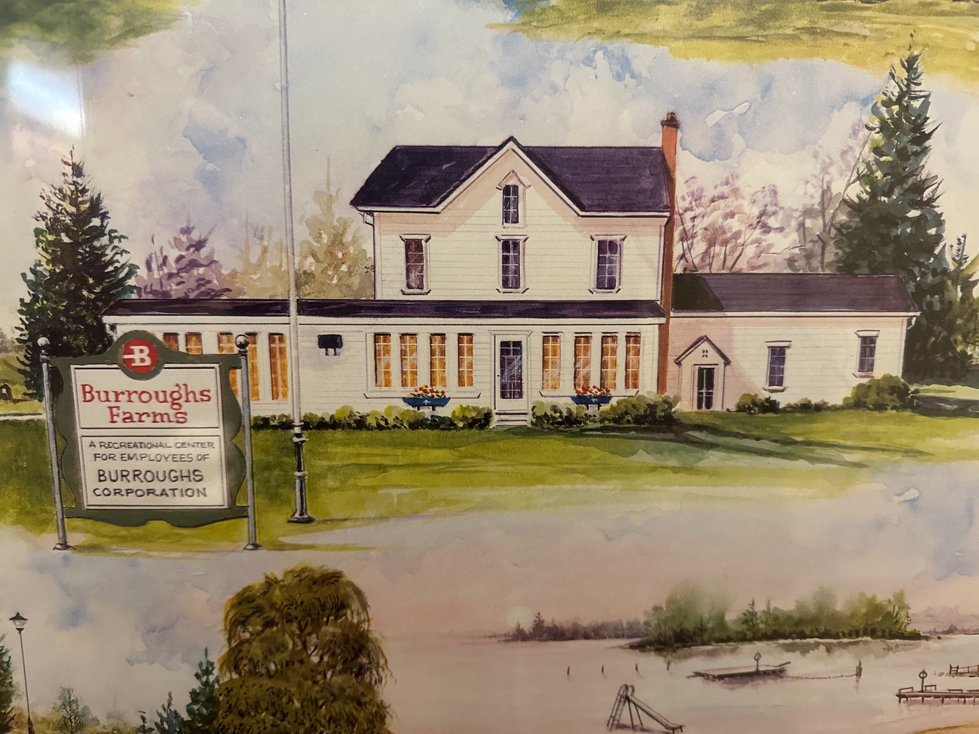

Bringing Burroughs Back to Life.
Brighton’s Social Slice of History

Slide 2
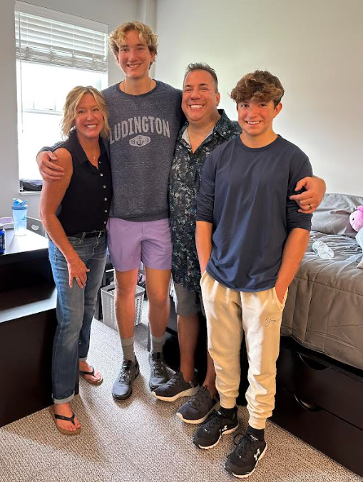
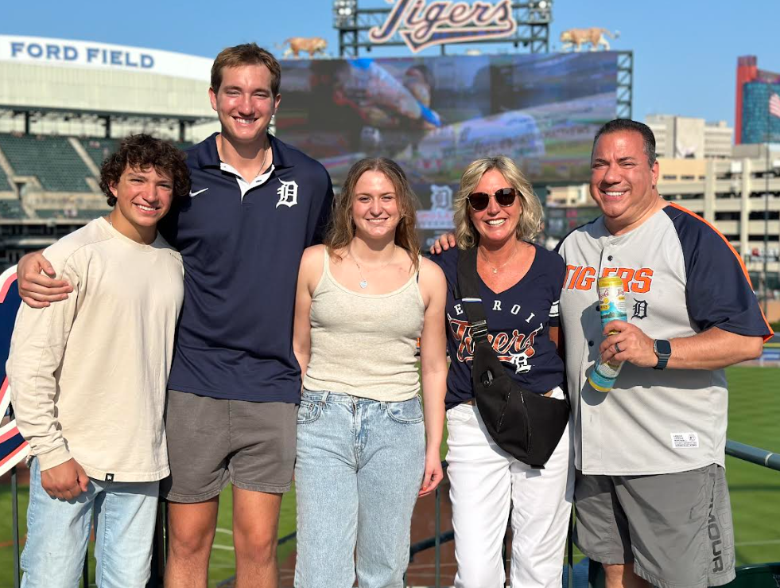

About Us
Andrew and Beth Perri are long-time residents of Brighton, Michigan having moved here in the late 1970s. Together, they lead a family-oriented financial service practice in Brighton, emphasizing client relationships and long-term financial stability for all.
Their vision is to preserve some history and restore Burrough Farms, a place they would frequent when it was open decades ago.

Slide 3

Heritage meets hospitality in this inclusive neighborhood hub - Bur
Our Vision

Slide 4
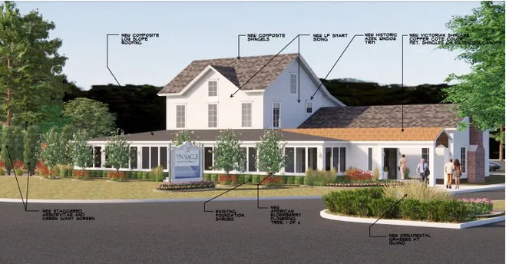
Our Vision

Slide 5
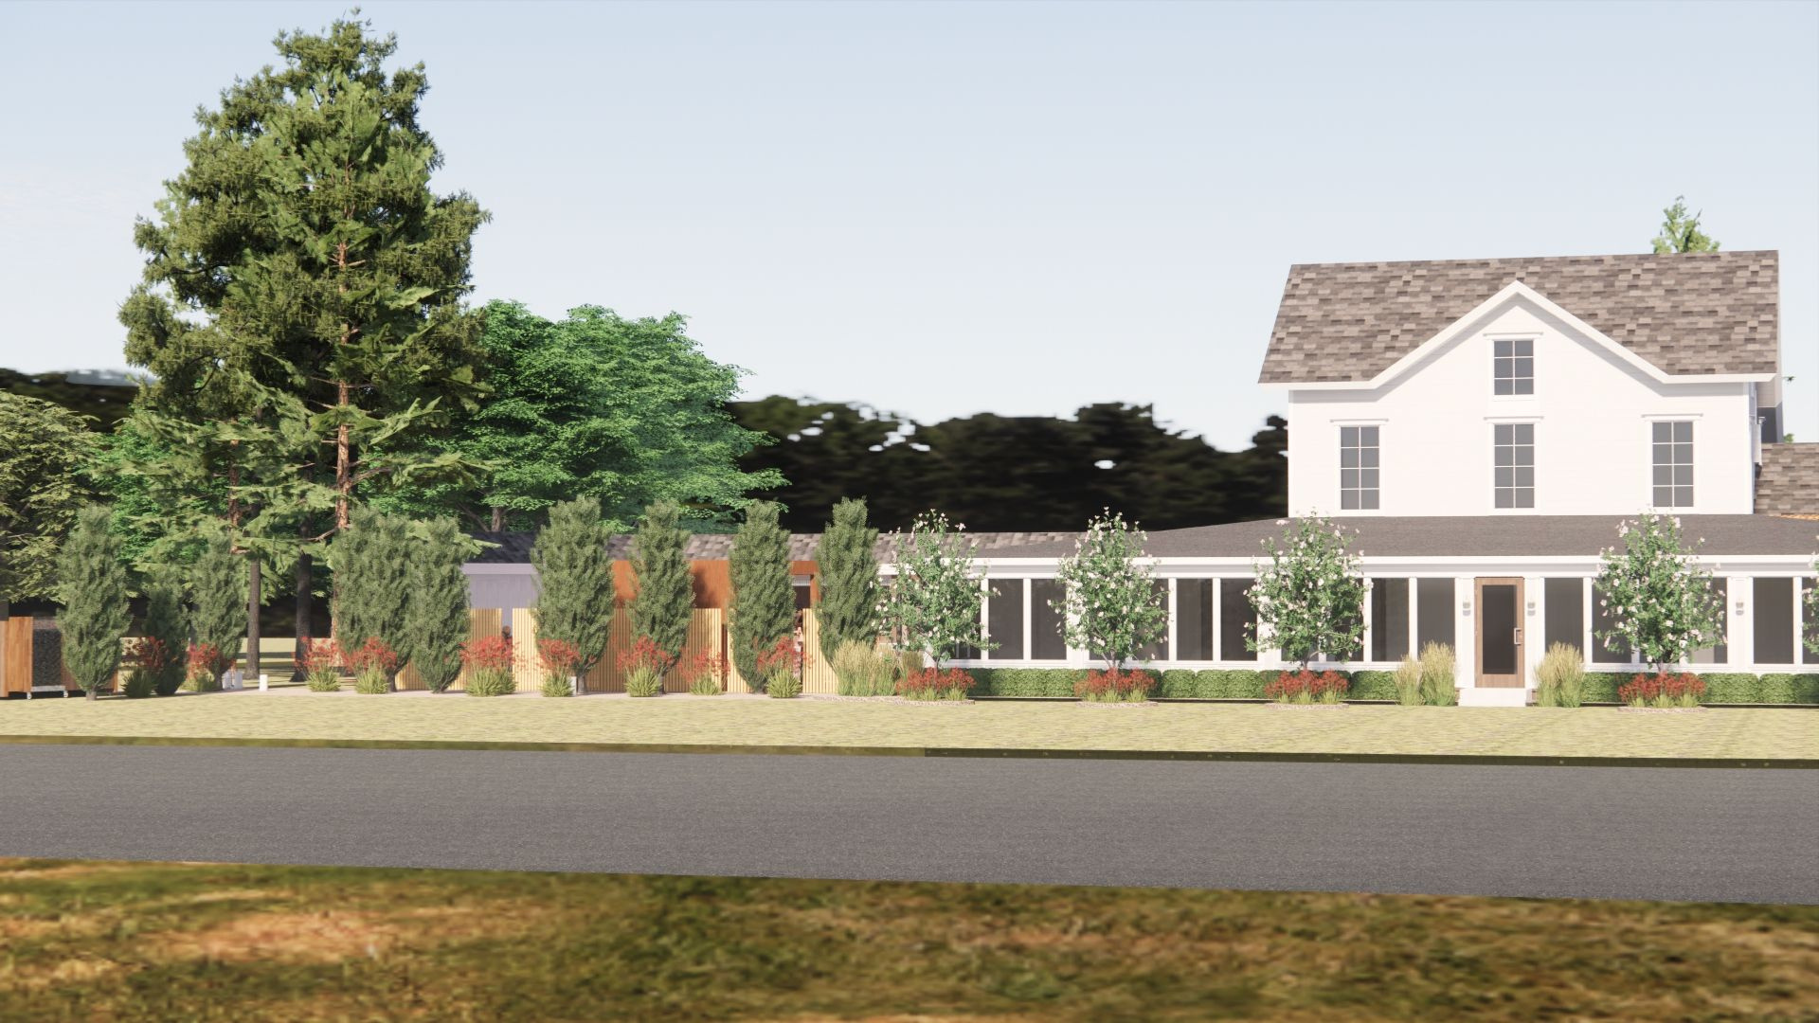
Heritage meets hospitality in this inclusive neighborhood hub - Burroughs Social.
Brighton’s premier social spot blends nostalgic charm and history with updated classy but casual dining and rentable venue and office space.
Our Vision

Slide 6
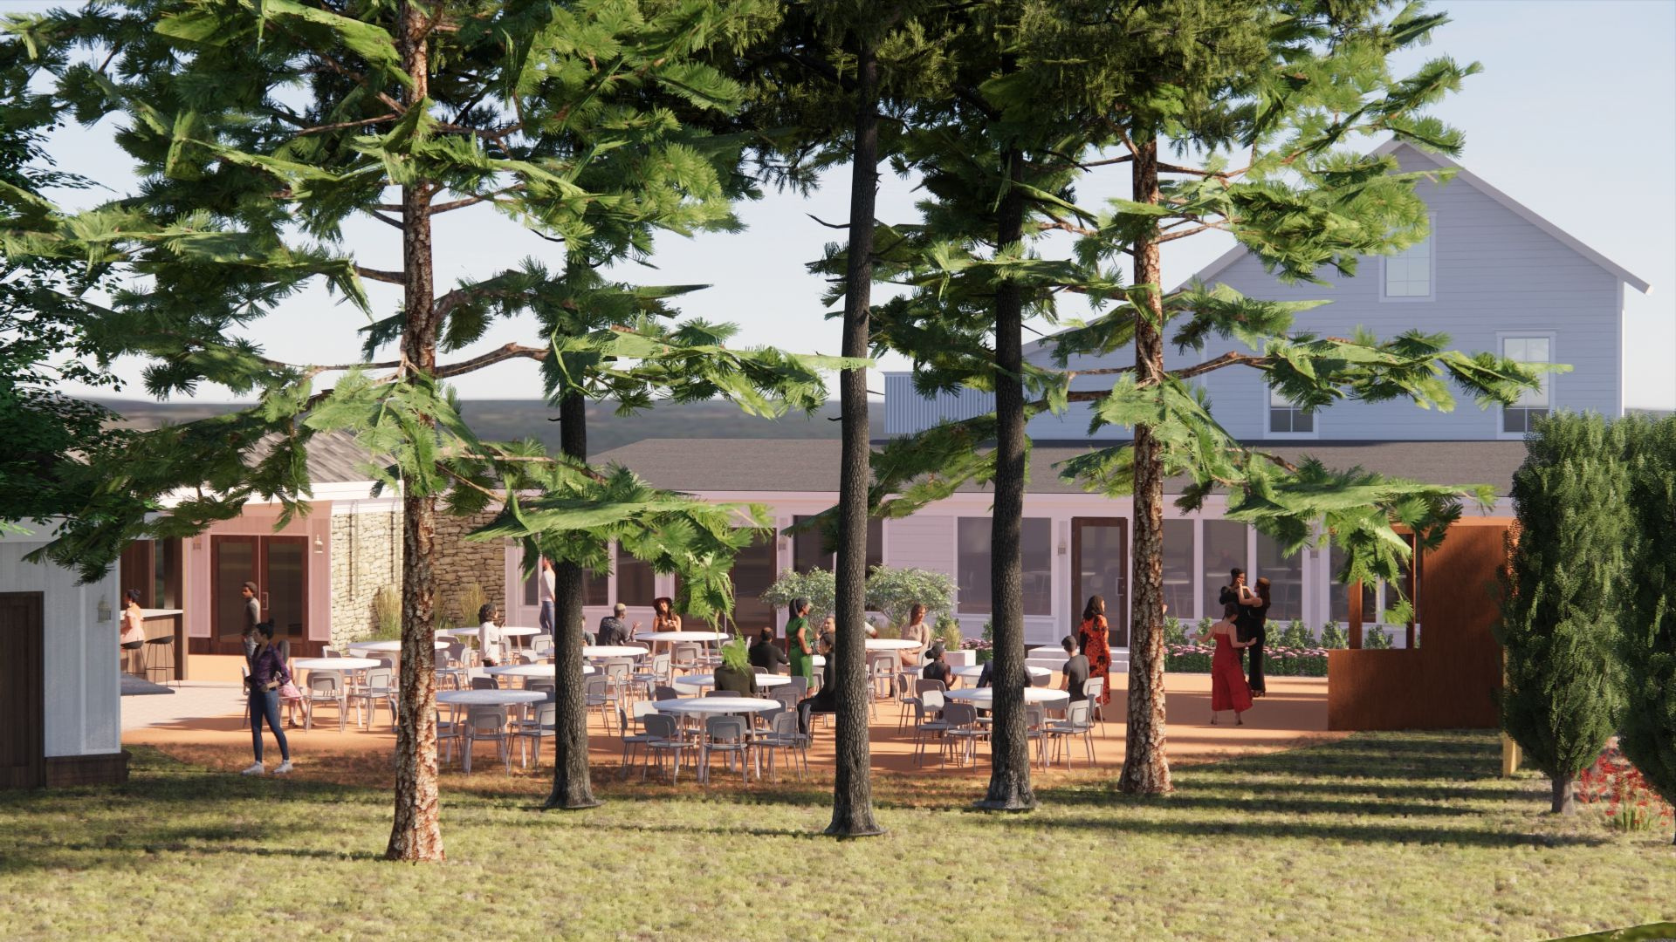
Highlights
Historical site overlooking Oak Pointe Country Club
Affluent family-oriented demographic within the local area
Tons of Partnership opportunities within Brighton and surrounding areas
Deep commitment to preserving history while bringing new life back to the farmhouse for the local community and beyond

Slide 7
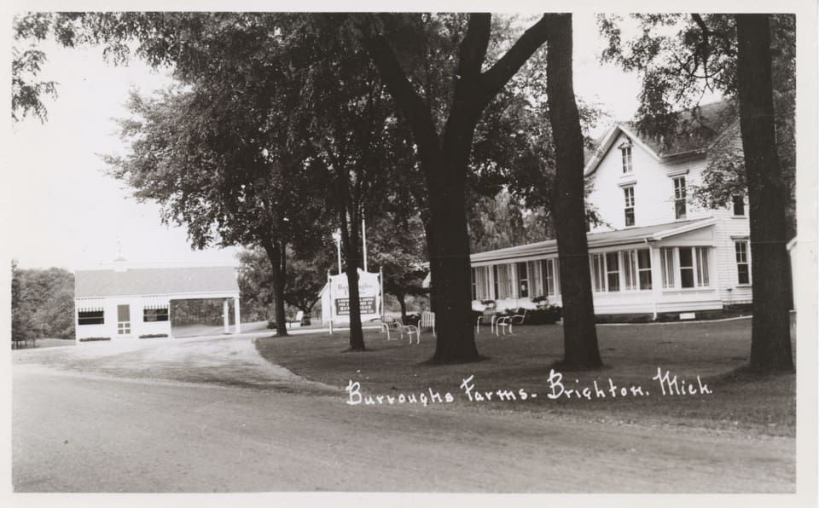
Brighton has a competitive but thriving casual dining scene, with a strong demand of pizza nd social pubs/bars.
A location overlooking Oak Pointe could attract affluent golfers/residents for upscale pizza, craft drinks, and patio dining.
Population of Brighton Township- 19k+ residents with a median age of 43-47.
Market Opportunity
Median household income within Genoa Township - $126k+, well above Michigan average of $$71,000.
Data primarily from U.S. Census Bureau American Community Survey

Slide 8
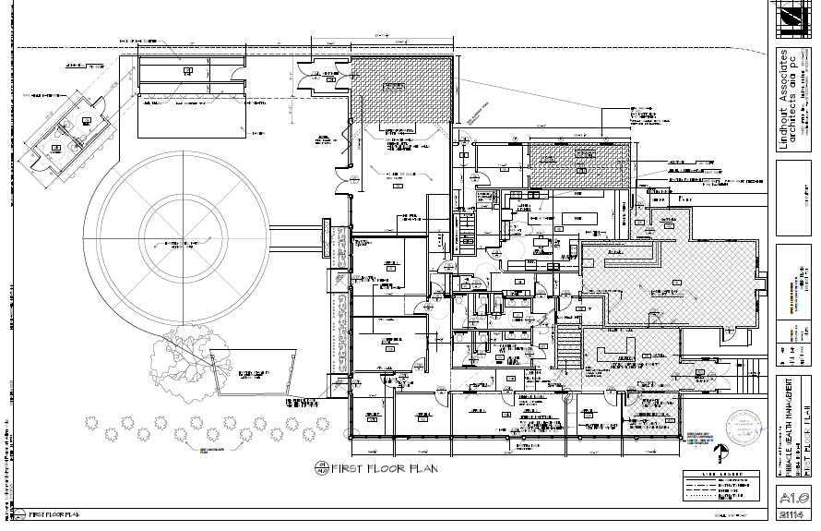
Core Concept
70% rentable office space
Potential rental income =
30% Social Pub Space
Peak weekend social gathering spot while keeping things sustainable and giving priorty to private events mid-week
Potential business income =

Slide 9
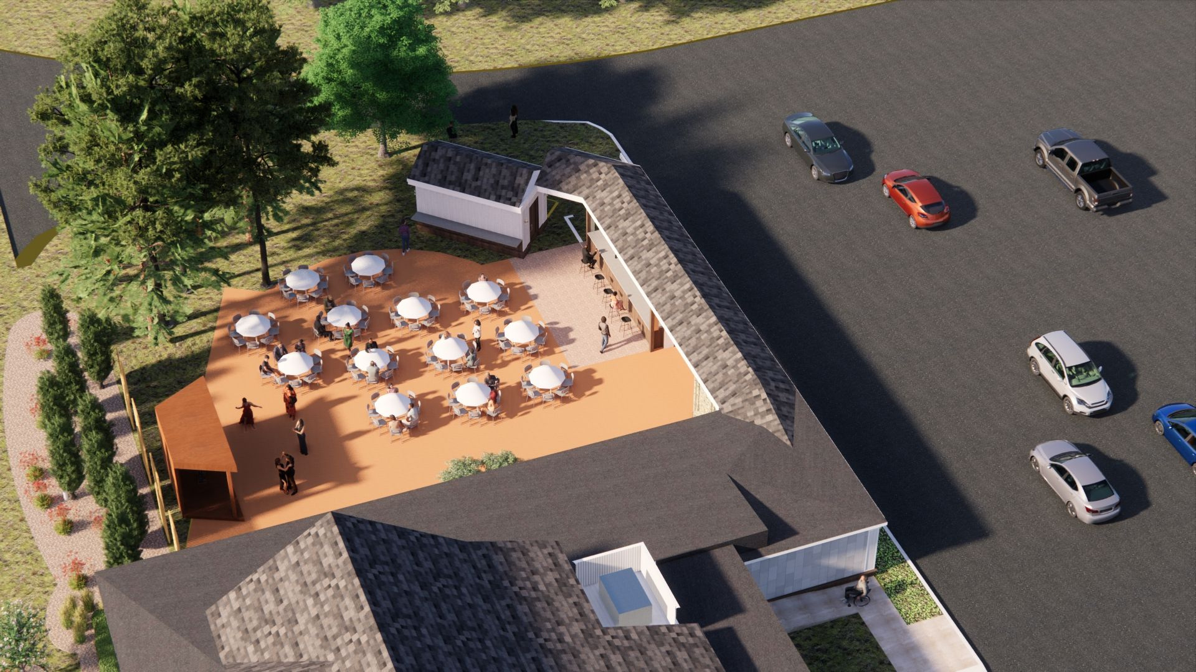
Outdoor Patio
Standout feature of the neighborhood pub designed to feel welcoming, elevated, and truly community-oriented
Private and permanent indoor restrooms for patio use only
Dedicated area for stricly controlled live or ambient music - enhancing community energy without being overwhelming.

Slide 10
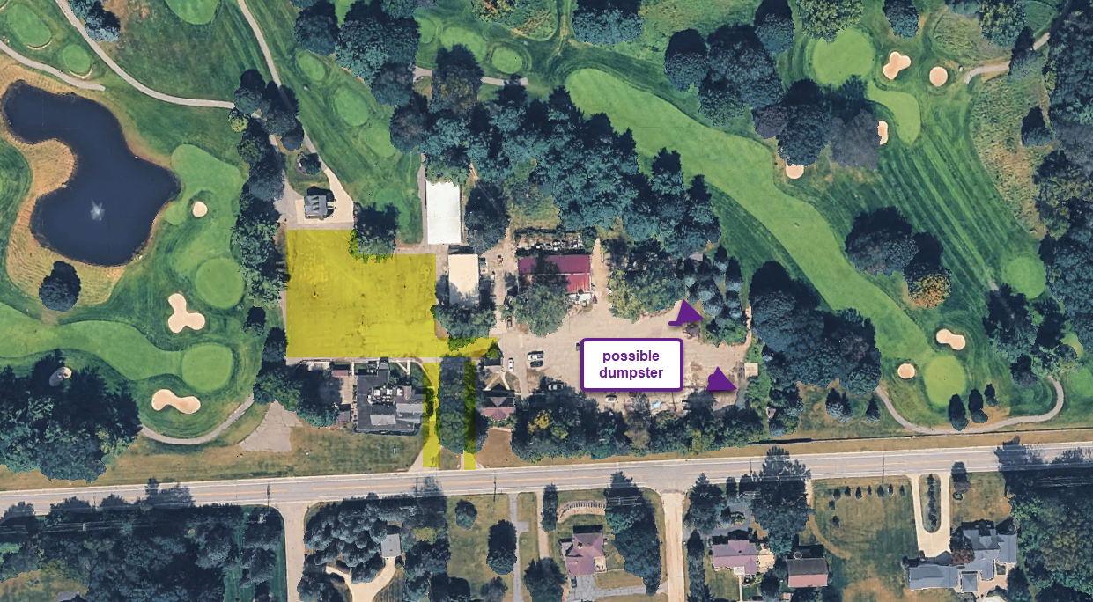

Slide 11


Slide 12
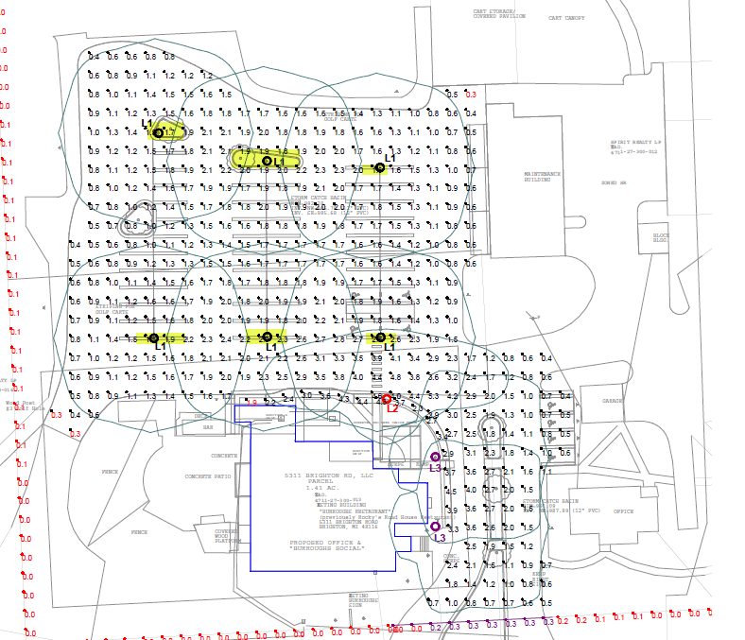

Slide 13
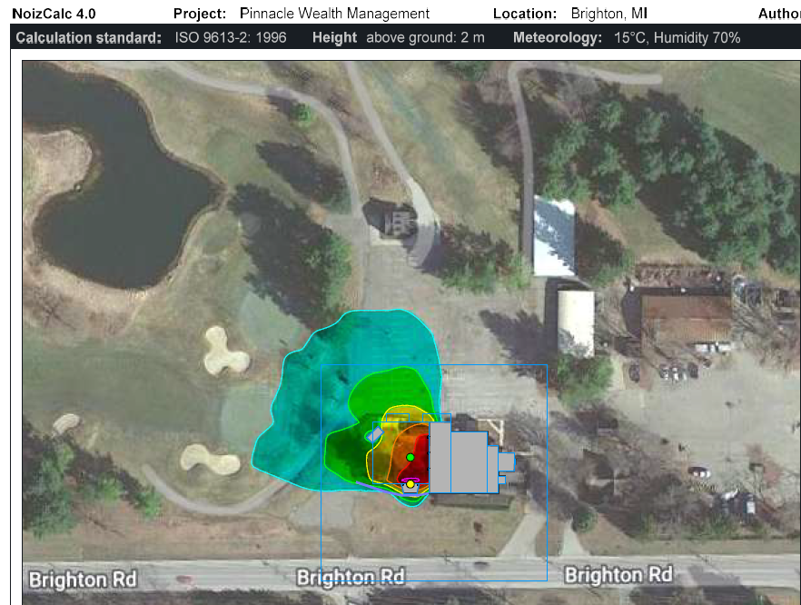

Slide 14
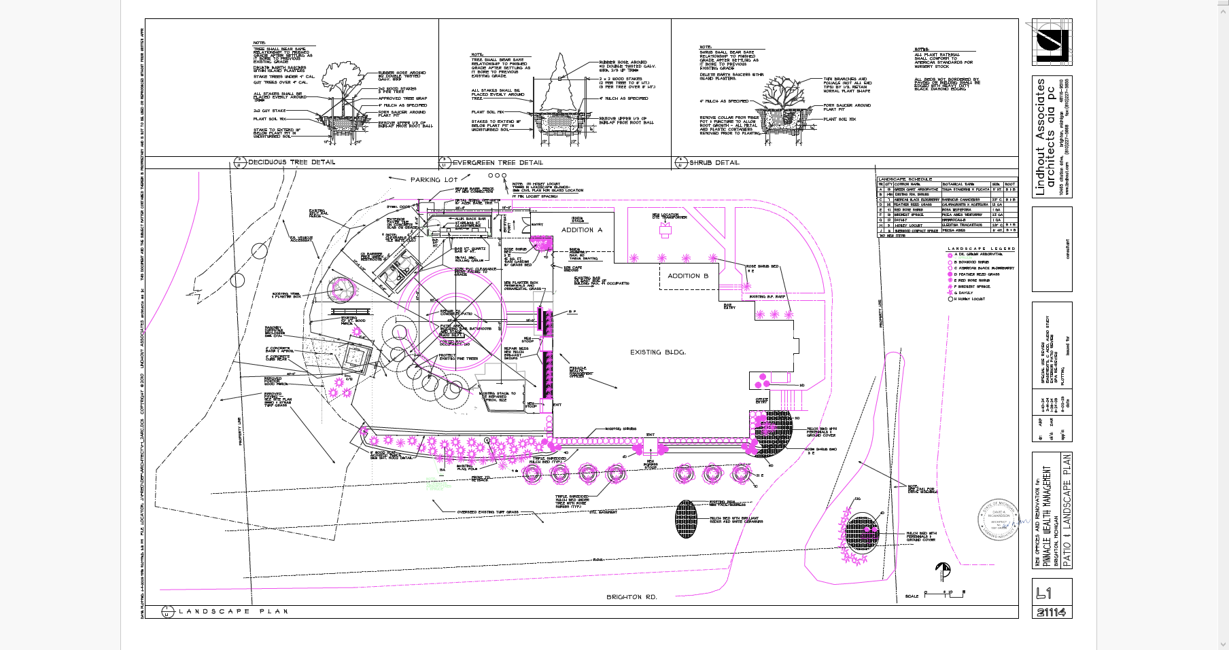

Slide 15




Thank You
Very Much!
Contact Us
  586-707-0182
  aperri@pinnaclewealthonline.com

